Slide 1
Title
Fedor Chursin, Borislav Nachev, Wesley van Gaalen, Francisco R. Mansilha, Vlad Bogdan Narcis Matache
Dr. Alican Noyan, Dean van Aswegen, Jason Harty
Dr. Vinicius M. Lube, Dr. Valerian Meline, Dr. Marciel P. Mendes
Notes:
1 – 3 Fedya

Slide 2
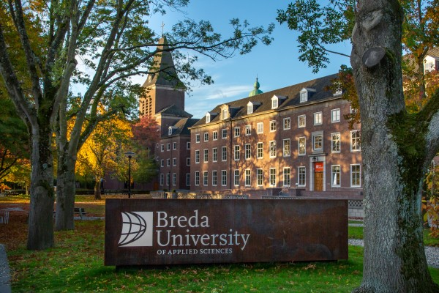




Applied Data Science and AI program
Since 2021, currently 200 students, will be 400 students
Project based education with 4 projects per year
Each project is with a real client
Notes:
1 – 3 Fedya

Slide 3
You can think of this as the outline
Part 1
Part 2
Y2B
all students
Y2B extension
5 best students

Slide 4
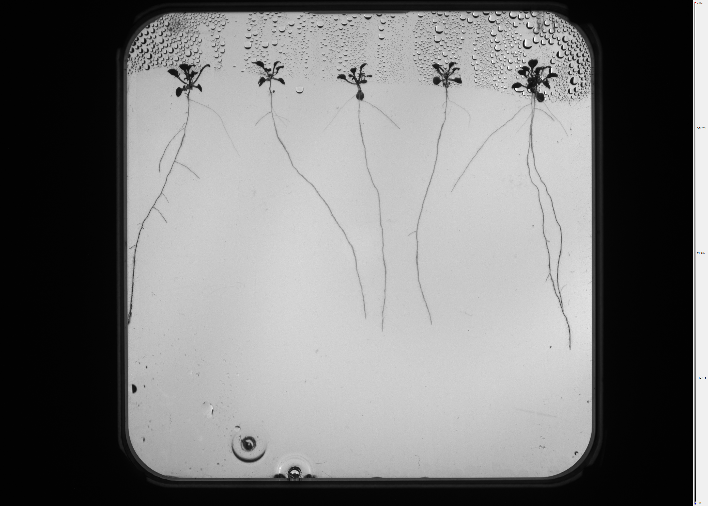
Problem definition
Notes:
4-5 Boris
Timeseries is not used to analyze

Slide 5
The dataset + labeling

Slide 6
Segmentation model
U-Net
Segmented image
Describe and report F1 score
Notes:
6-7 Vlad

Slide 7
Project Flow

Slide 8
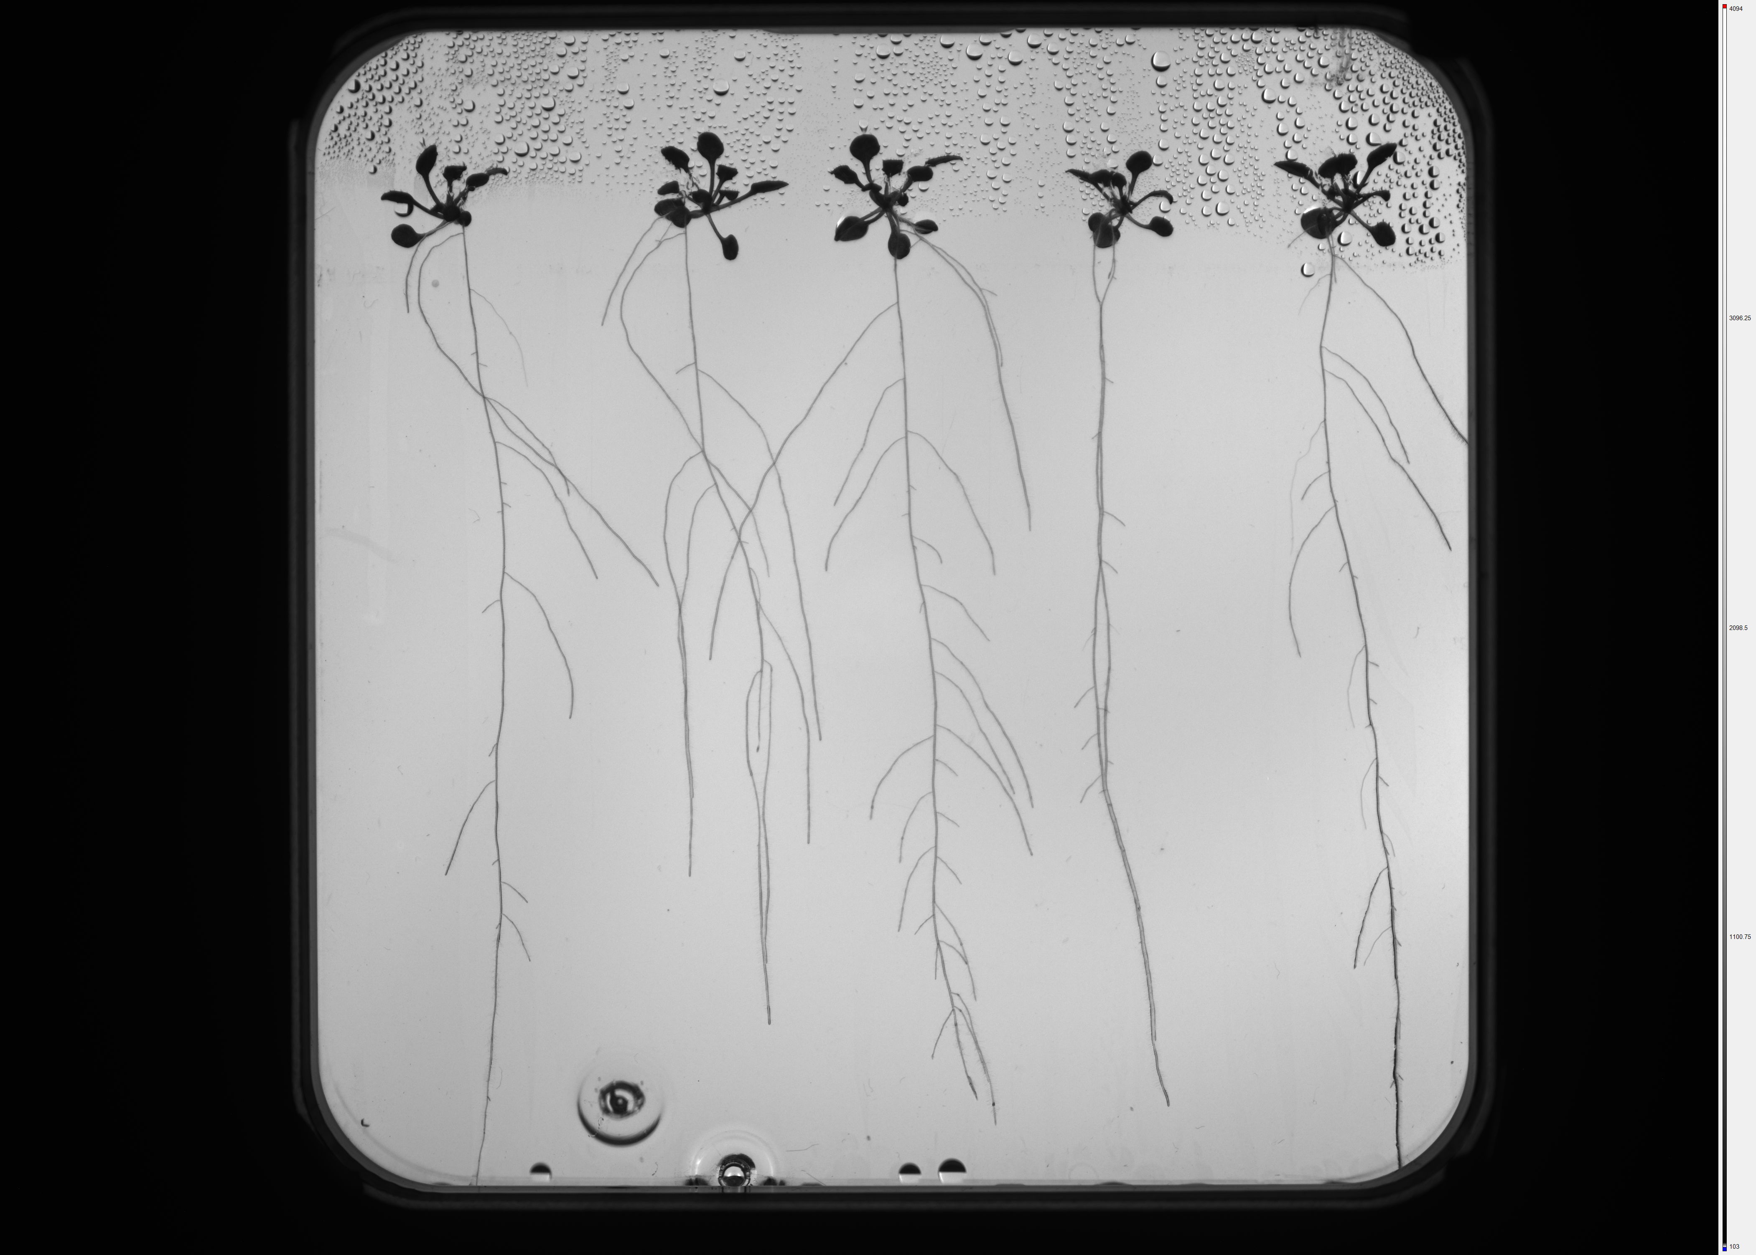
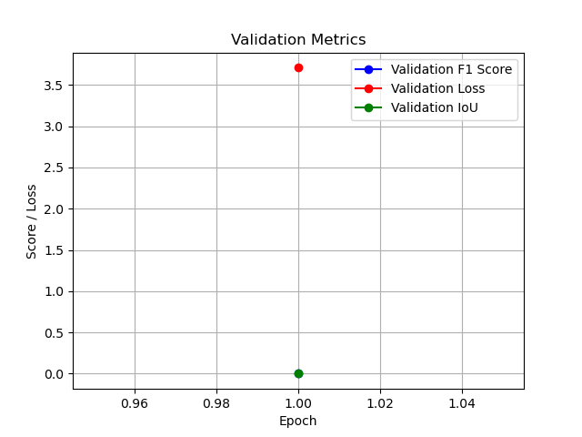
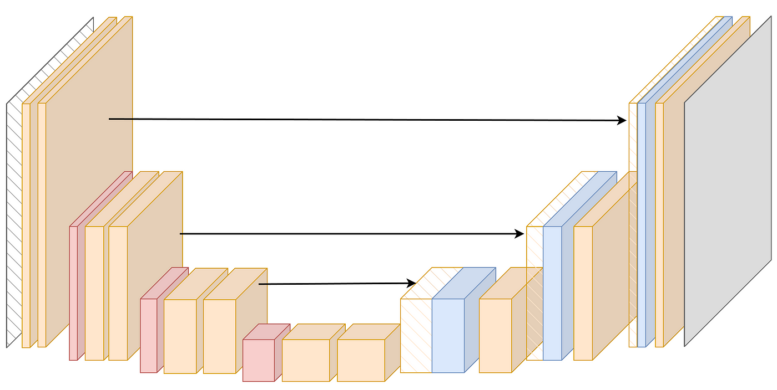
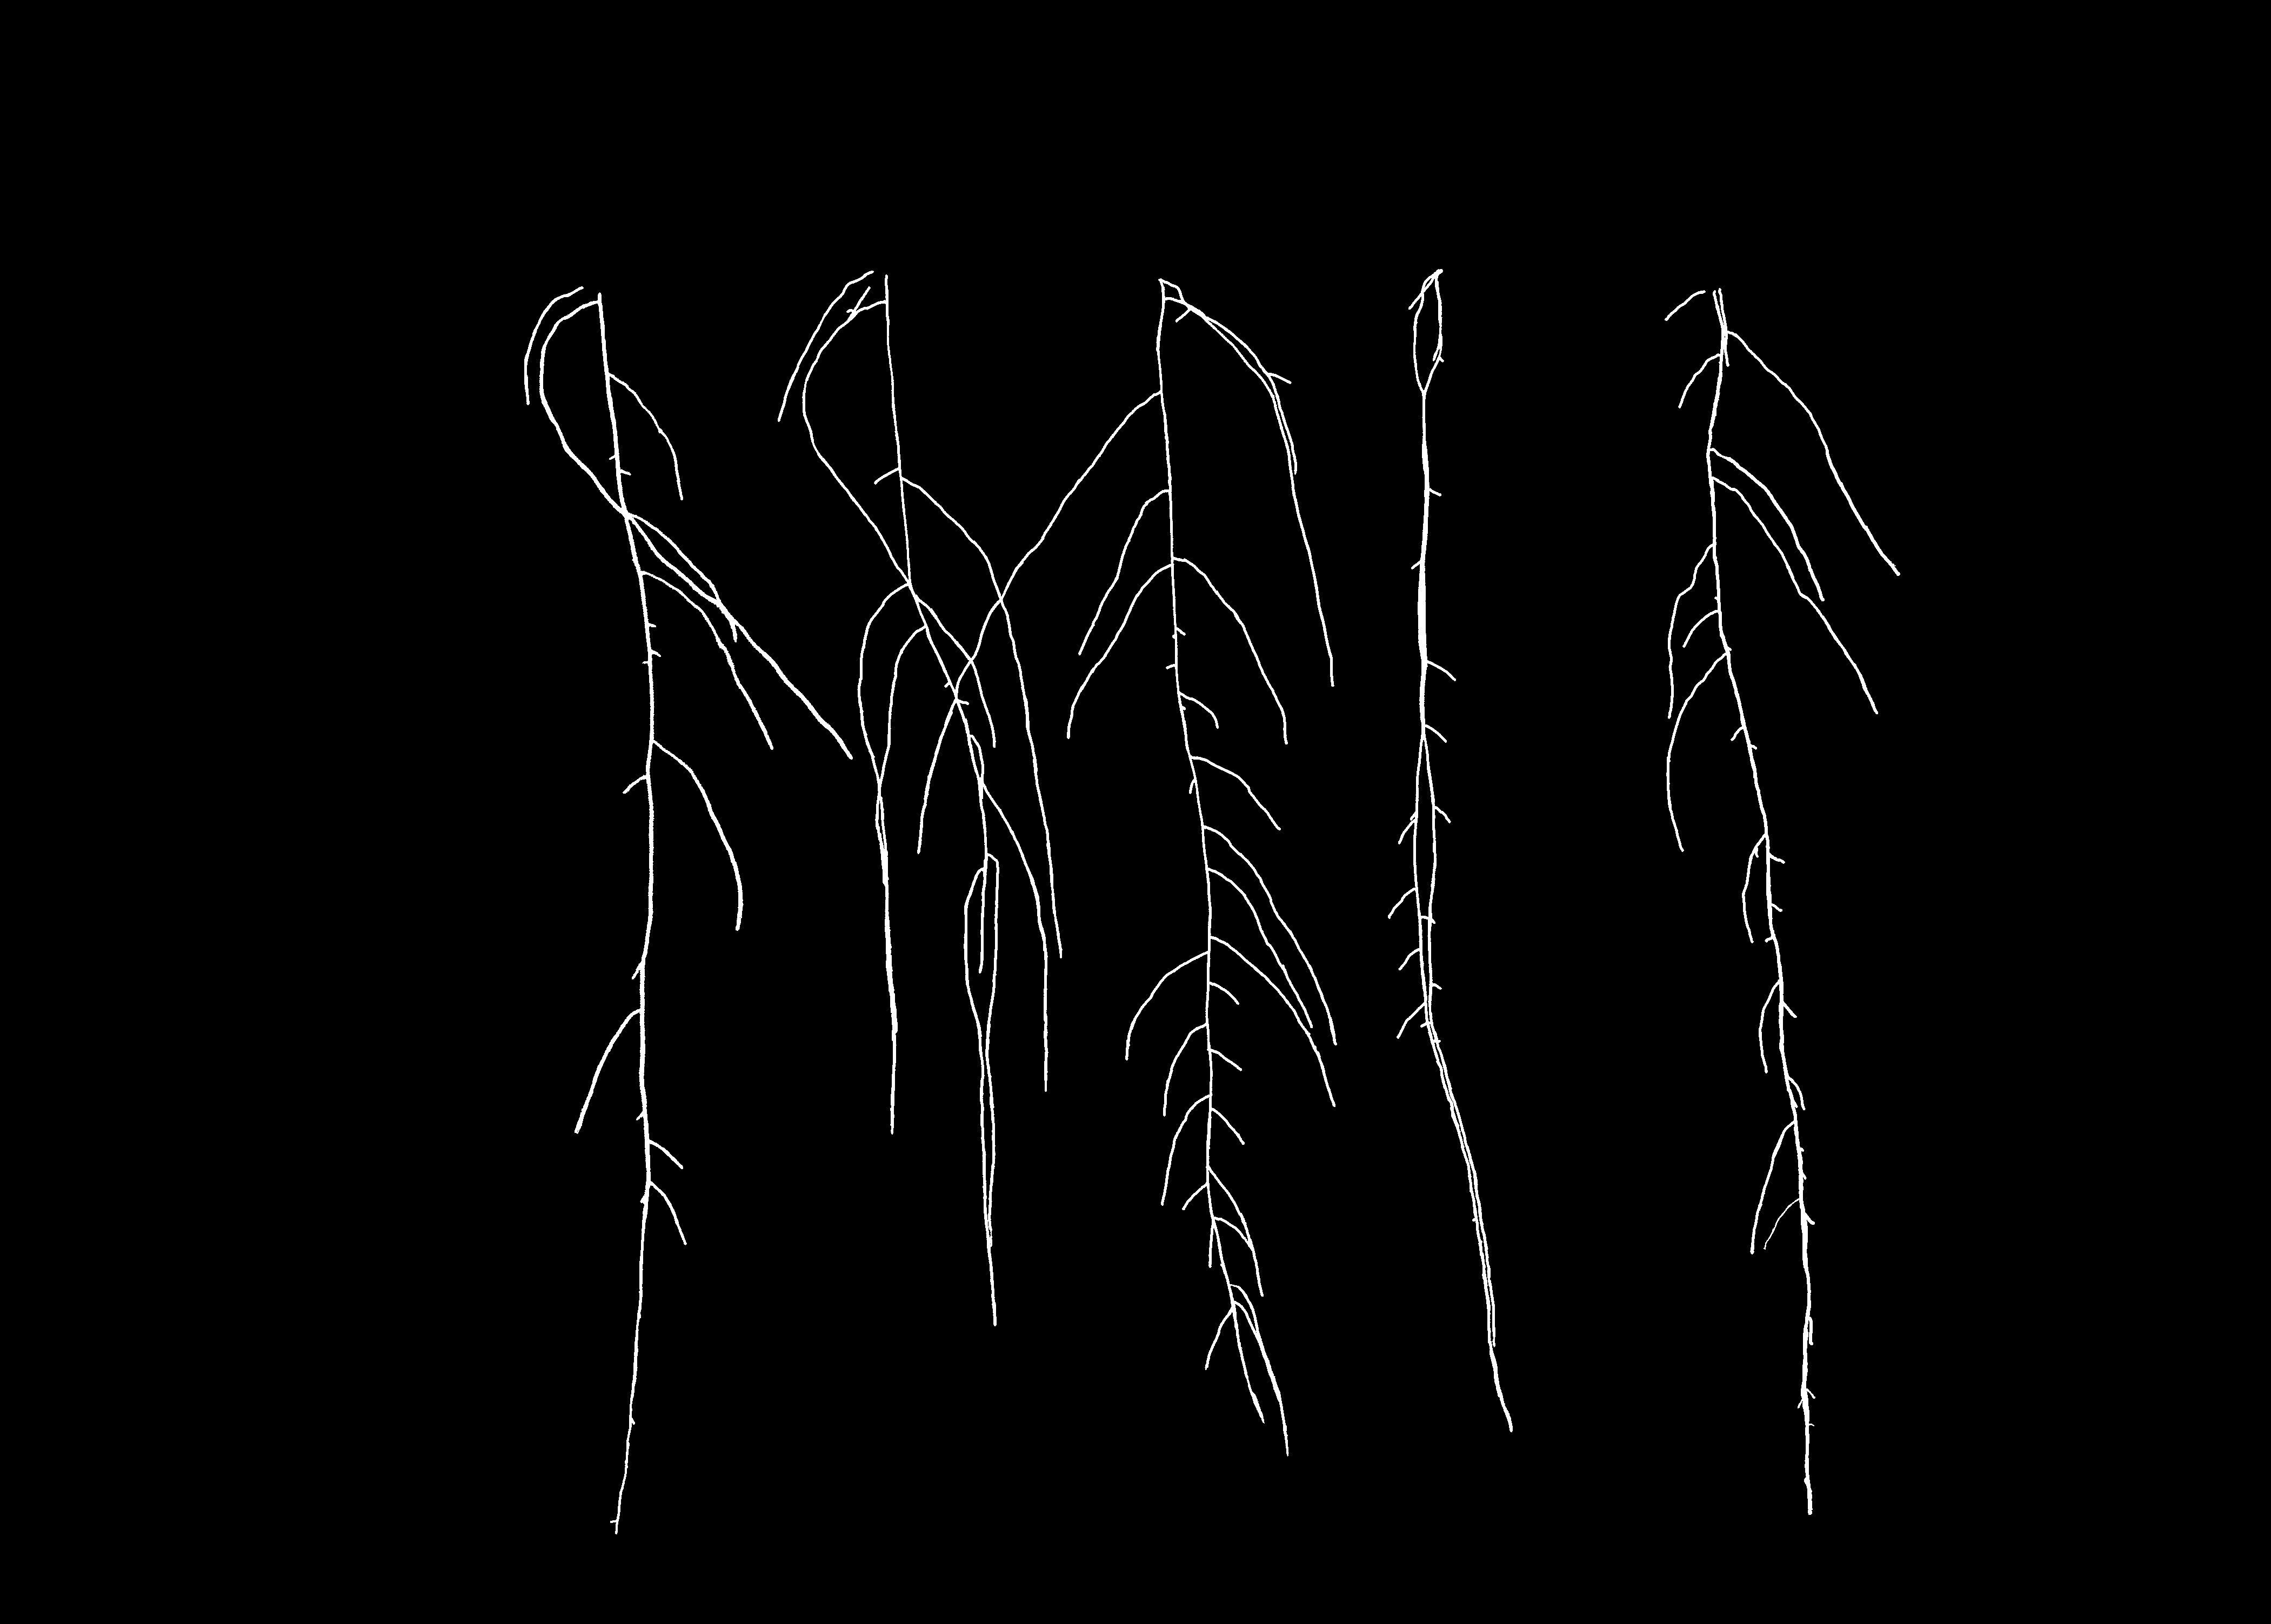
Input Data
U-Net Model

Slide 9

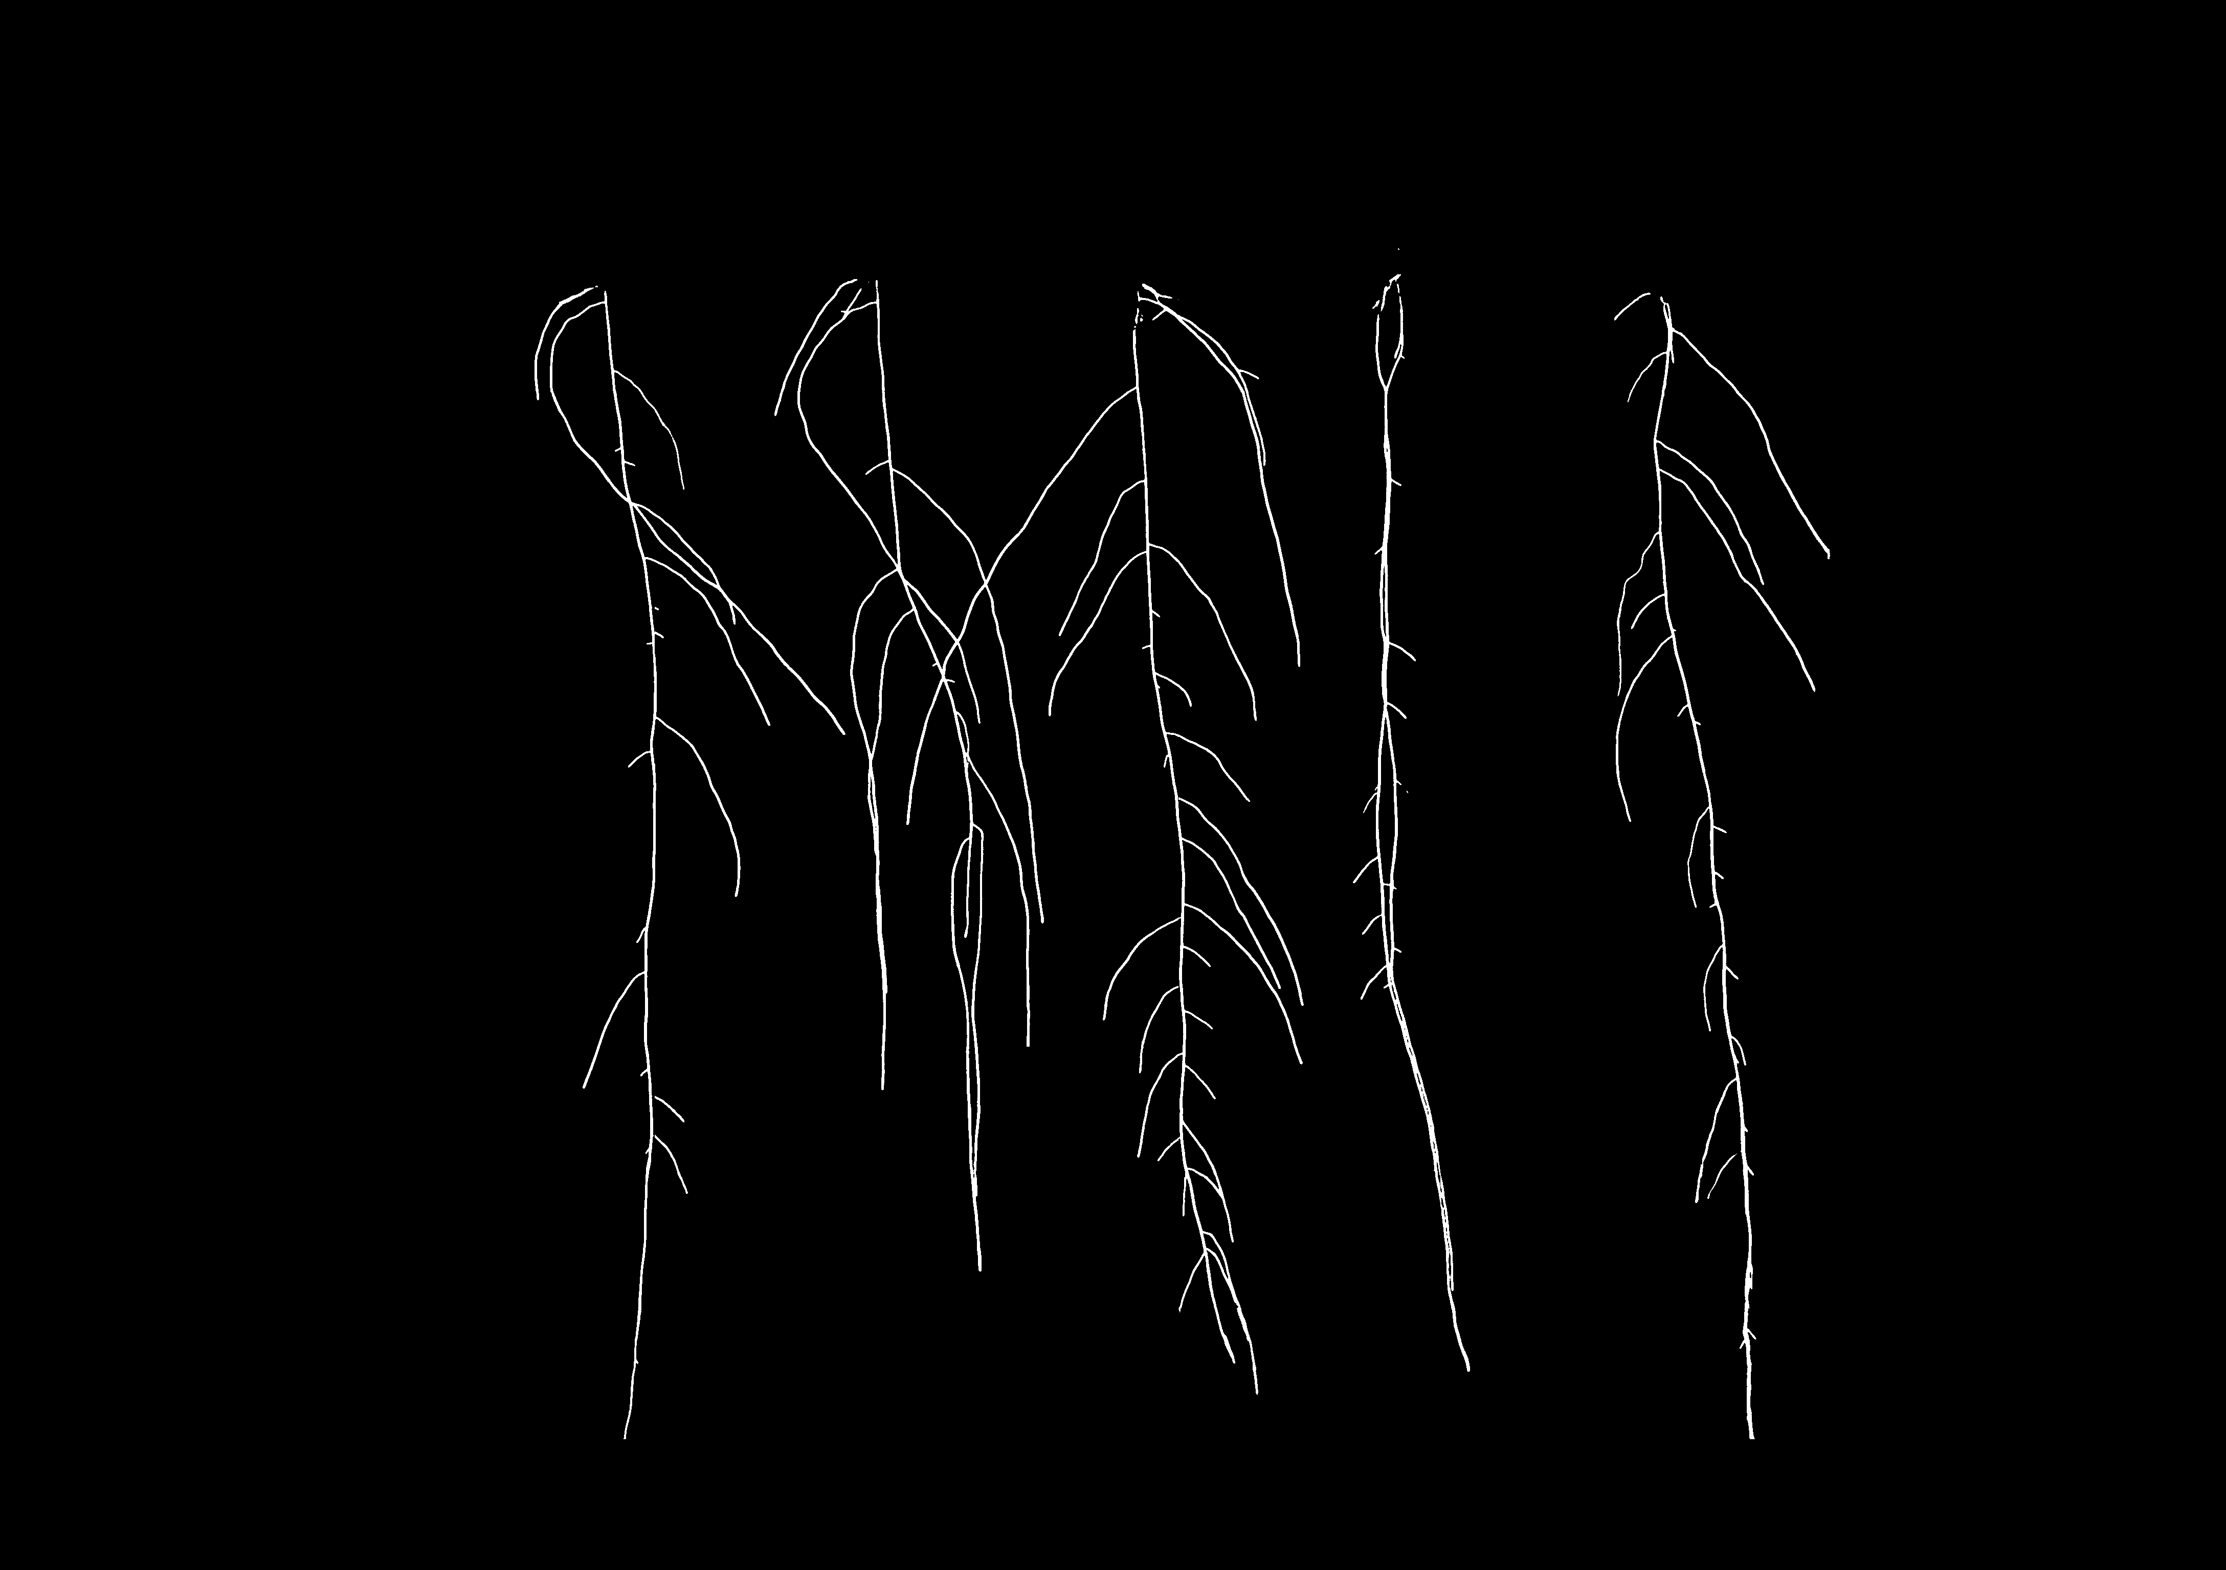
Input Data
U-Net Model

Slide 10
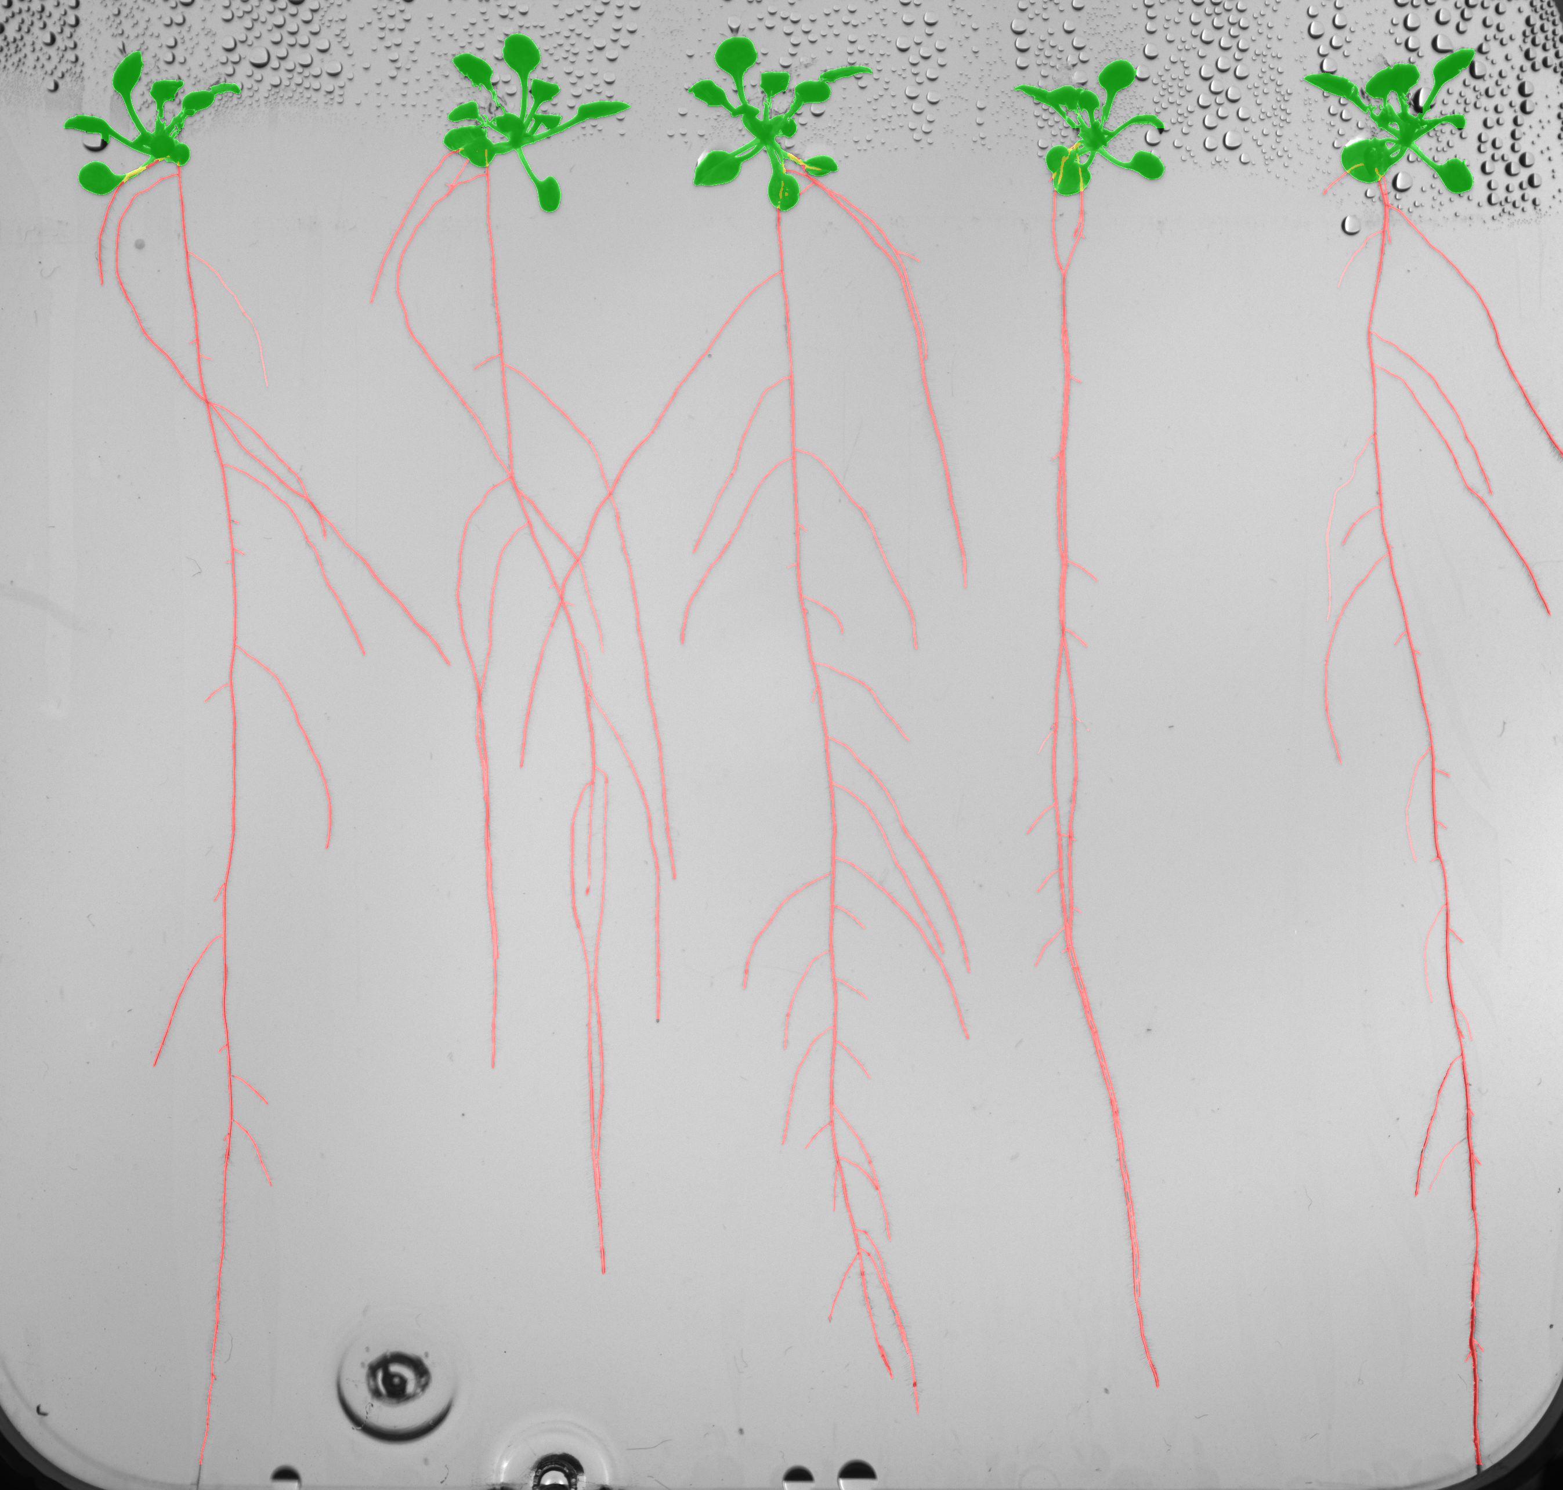

Slide 11
Plant 1
Plant 2
Plant 3
Plant 4
Plant 5

Slide 12
Final step
Primary root
Lateral root
Landmarks
Metrics
Notes:
8 – 10 Wesley

Slide 13


Slide 17
Lateral root

Slide 19
Mean Absolute Percentage Error

Slide 20

Kaggle Challenge

Slide 21
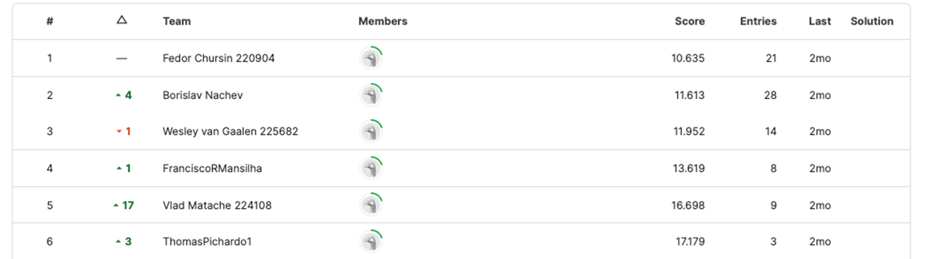
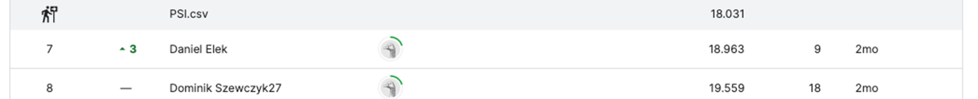

Slide 22
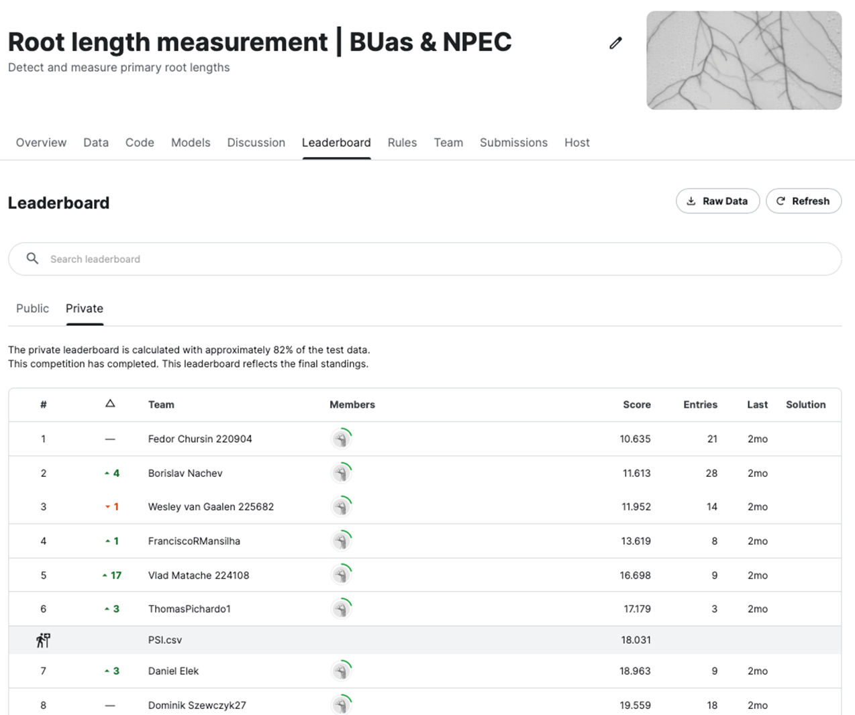


Slide 23
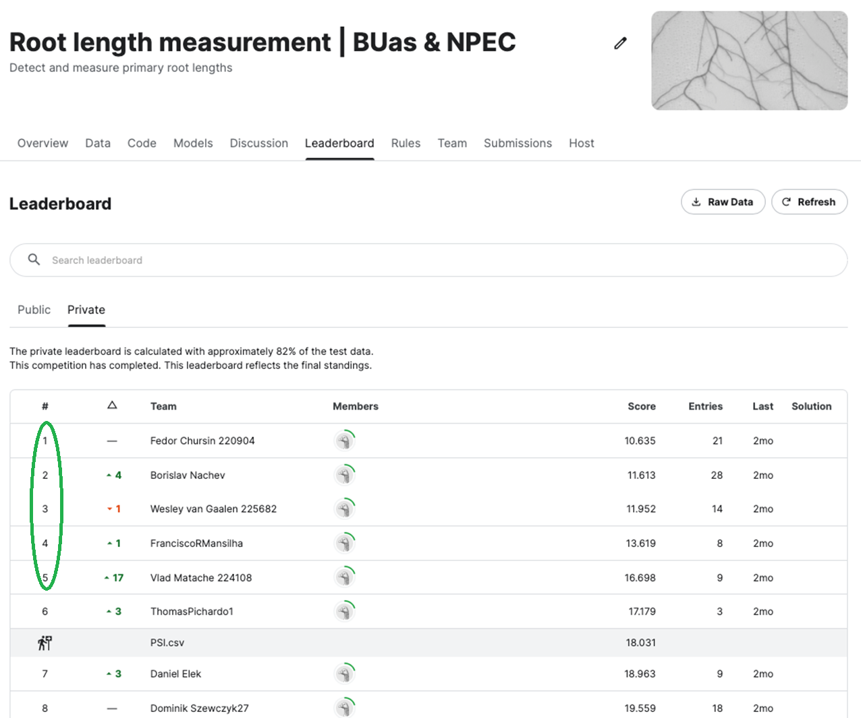

Slide 24
Robotics
Show simulation result, do not go into the details of PID/RL
Verbally mention PID and RL. You can prepare detailed slides, put them into appendix, and in case anyone asks about the details show them. This is the general principle.

Slide 25
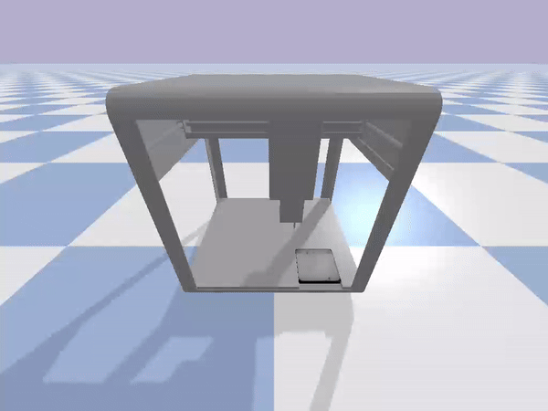
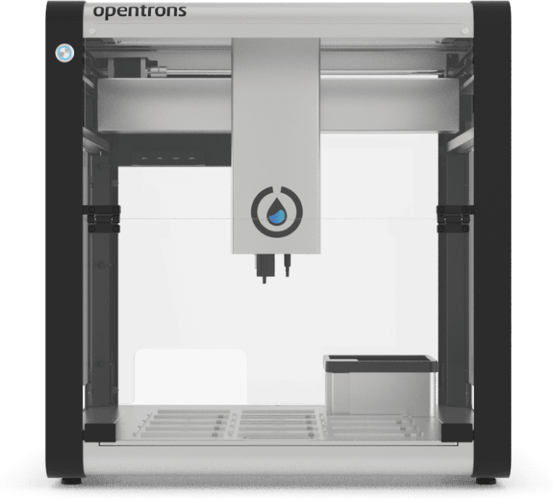

Slide 26
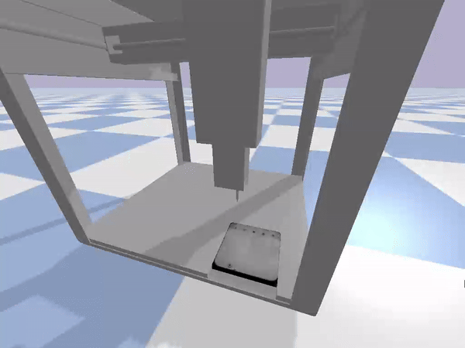

Slide 27
Limitations
Individual Project (Francisco + Vlad)
Small plants (not addressed, but the model is better)
Student labels (new data labelled by biologists + student data + new model) (Francisco + Vlad)
Occlusions (WIP Francisco, Borislav, Vlad)
Fixed number of plants (not a problem, but template is needed)
Overlapping (Fedya + Wesley)
No timeseries (pretend that we have it)
Simulation (discuss with Dean) (give coordinates move the robot)
Notes:
11

Slide 28
Part 2
Discuss how you are addressing each limitation from Part 1
1-3 slides per limitation

Slide 29
New Data labelled by biologists -> better model
Kaggle best performing solution
Small plants

Slide 30
Final Pipeline (combination of best features from all 5)
Appendix (for more details)
NPEC desired formatting

Slide 31
Occlusions
Show an example of occlusions (and not solved novelty!)
Approach (
Use real and simulated data to train a model to fix occlusions
Traditional computer vision approach
)

Slide 32
Overlapping roots
We are not limited by the number of 5 plants, but by the template provided ( fedya )
Show an example and how it was segmented before +
Show how it works now
Explain the approach ( subject to decide ) (prim root – lowest point, secondary root – Wesley's approach)

Slide 33
Overlapping roots

Slide 34
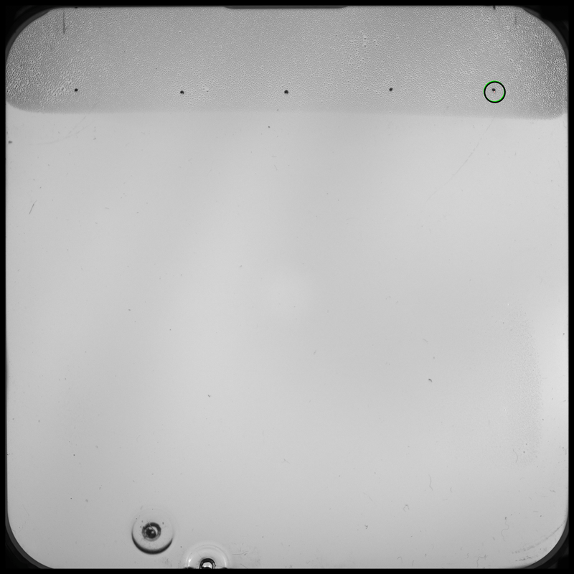

Slide 35
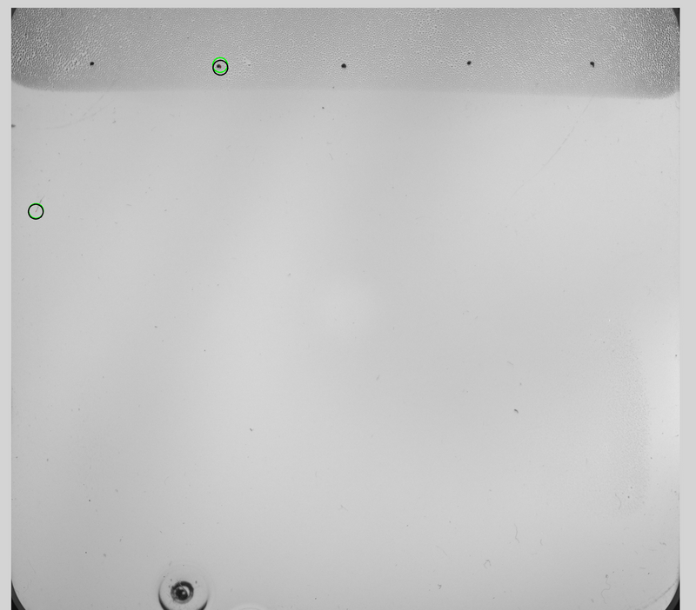

Slide 36
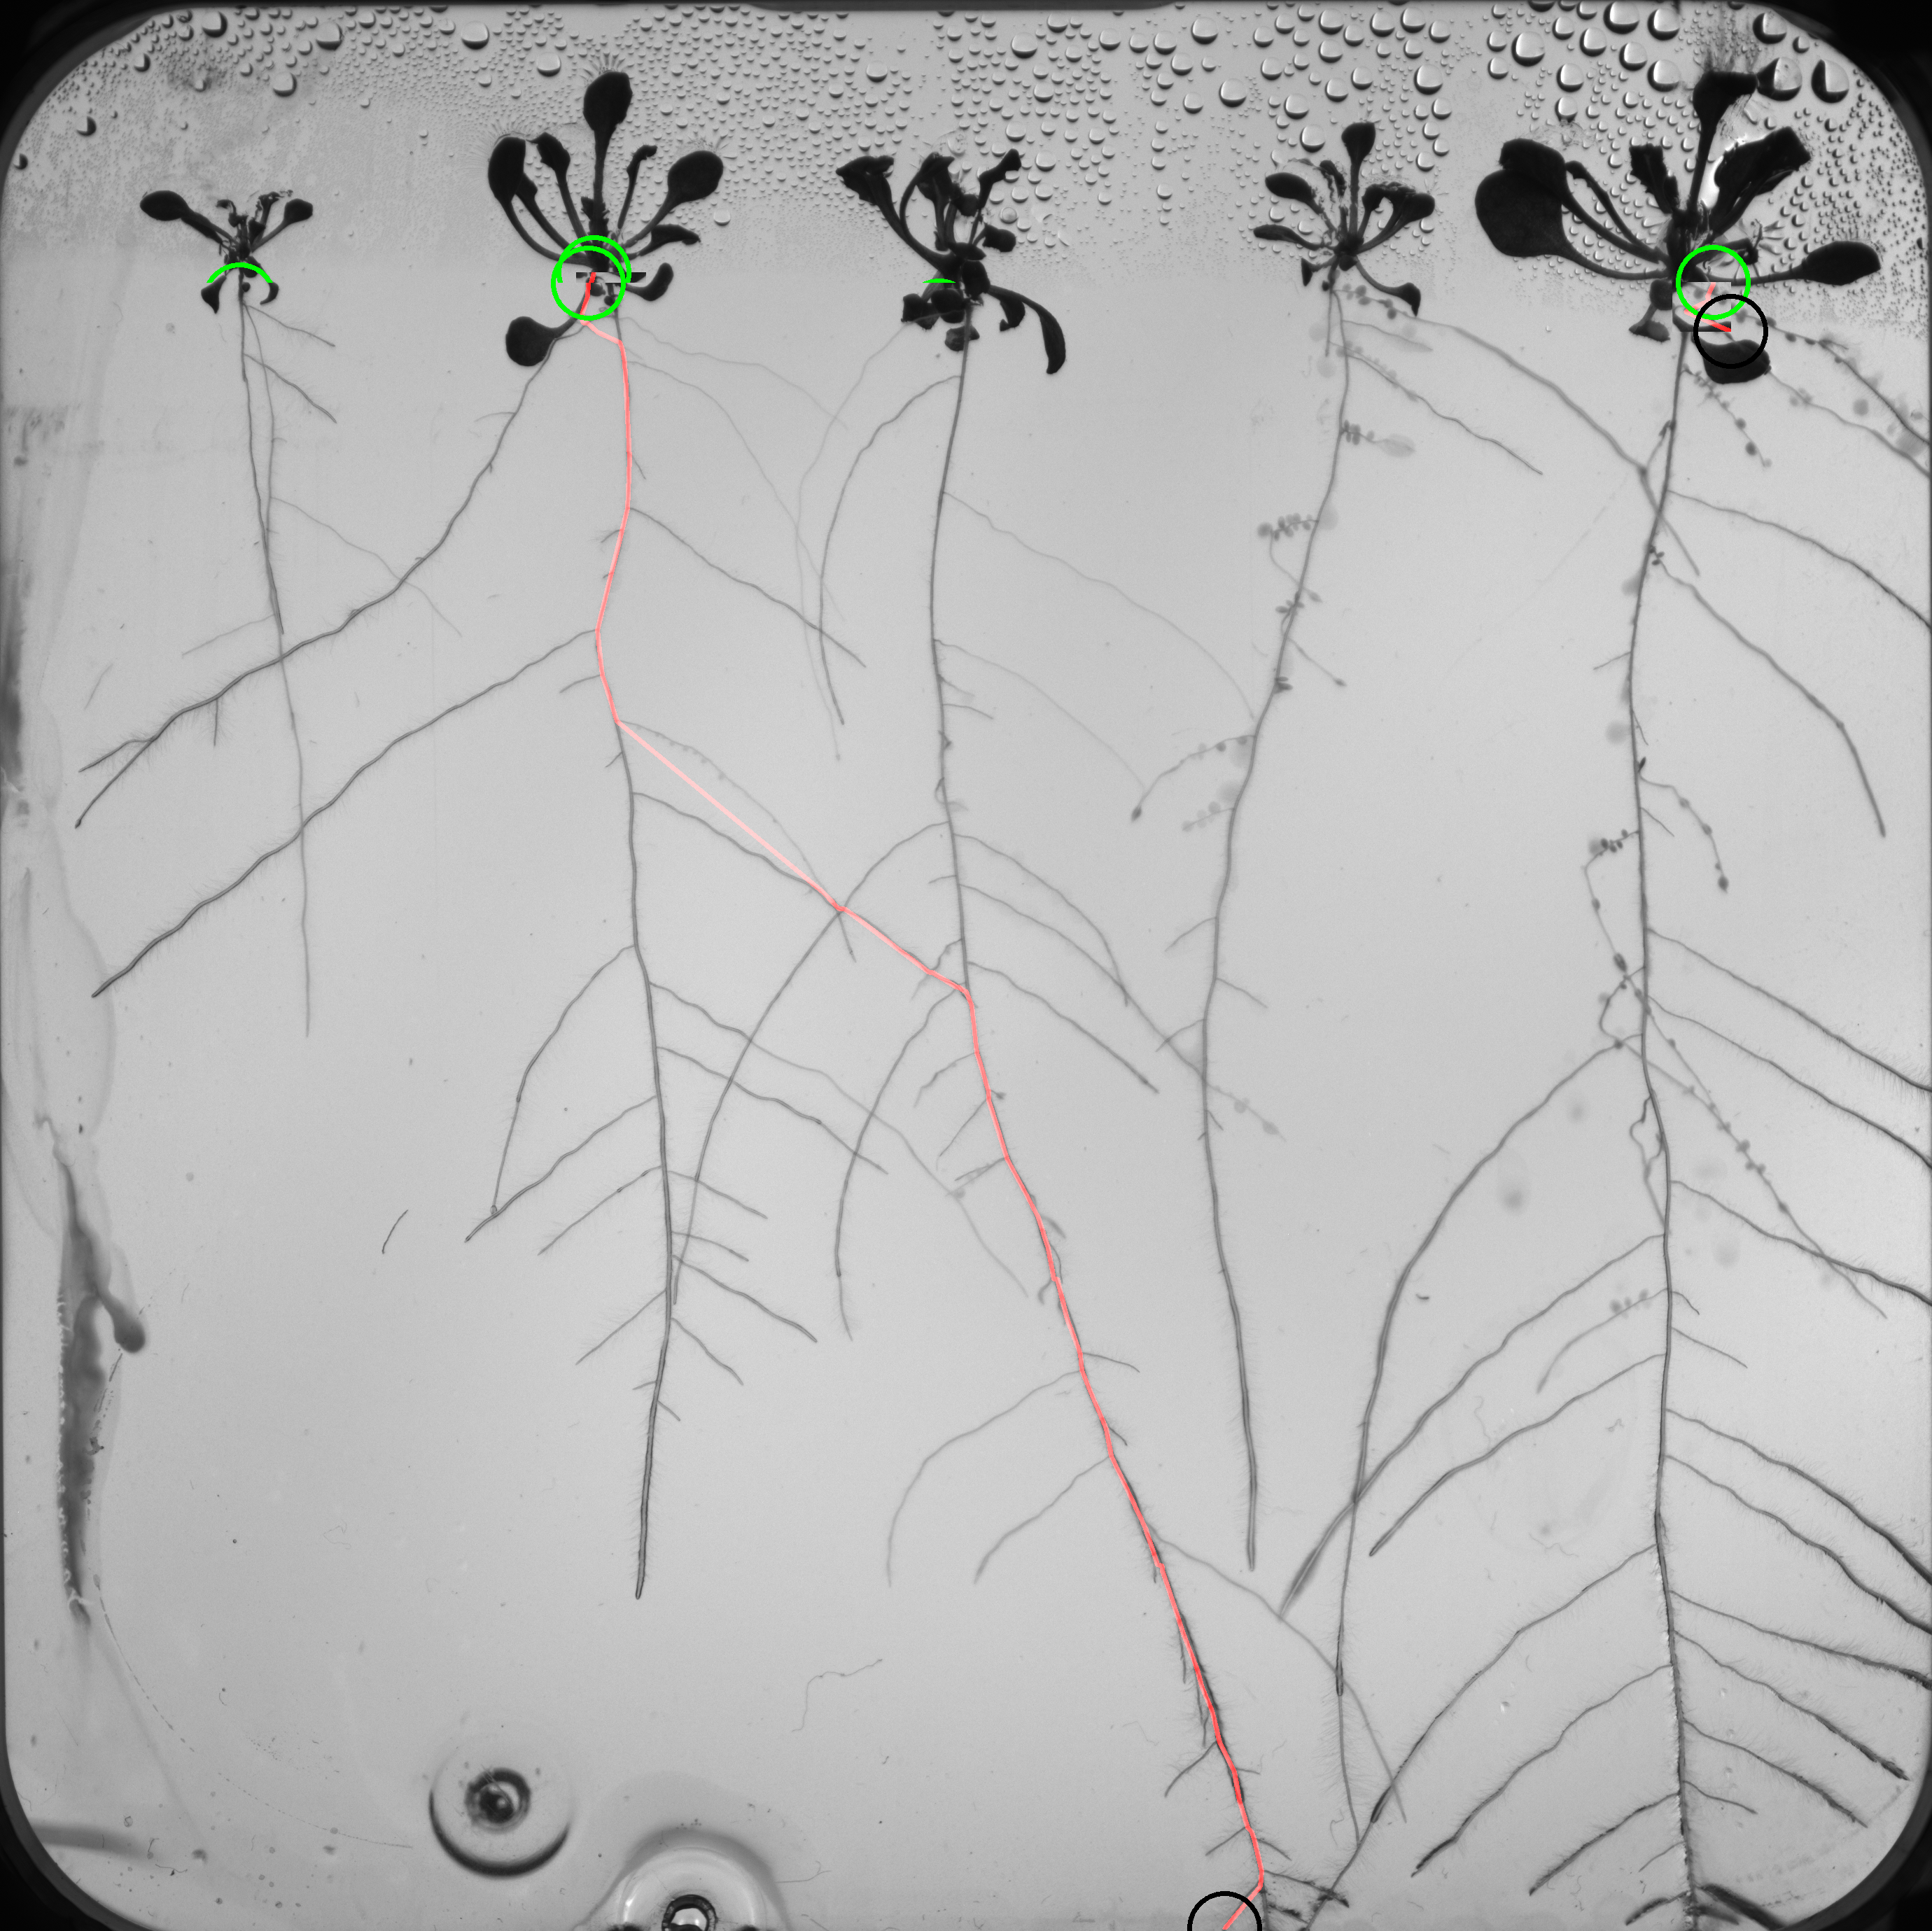
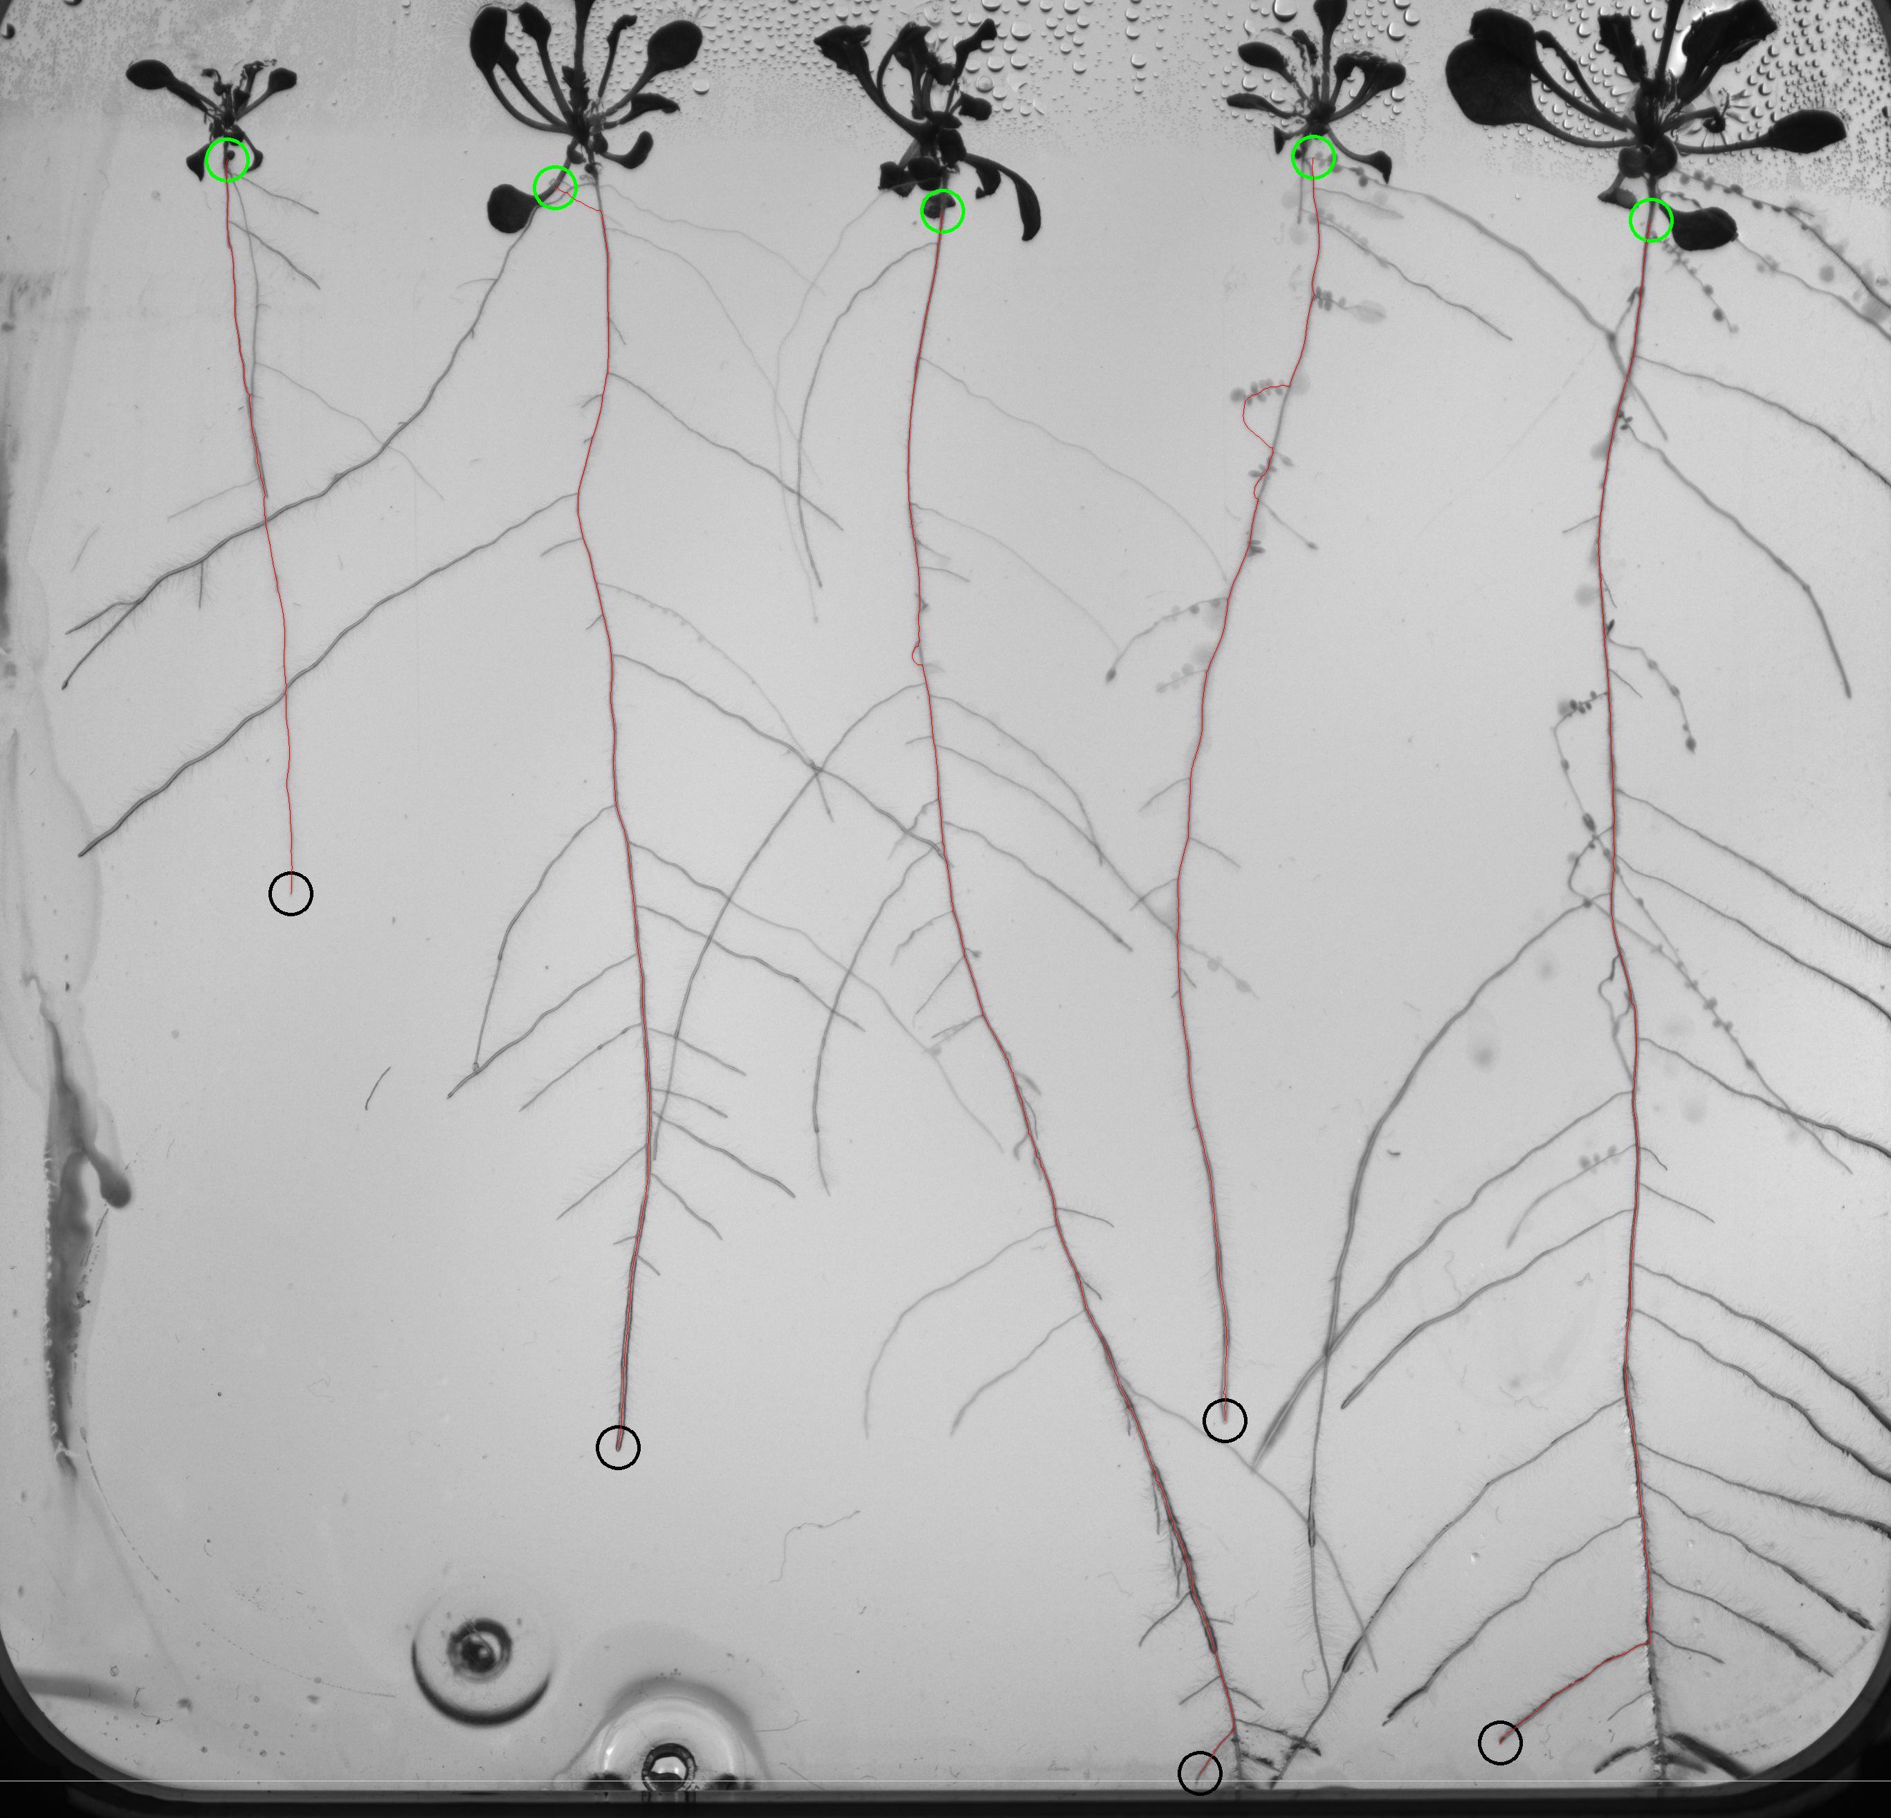

Slide 37
Future steps
Paper
Deployment (Y2D) (appendix for the details)

